Slide 1
DSCI 6004-1: Natural Language Processing
Names: UDAY SHANKAR AGASTI DAMODAR REDDY CHIRAPUREDDY KOWSALYA MAYALURI

Slide 2


Project Topic
Automated Cyberbullying Detection in Text Conversations Using Natural Language Processing
This project focuses on developing an automated NLP model aimed at identifying instances of cyberbullying within various forms of text conversations. By utilizing advanced NLP techniques and deep learning methodologies, the project creates a system that not only detects harmful behaviors in real time but also provides actionable insights for intervention.

Slide 3
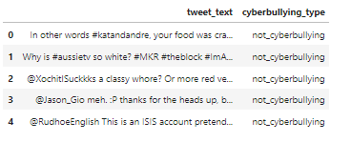
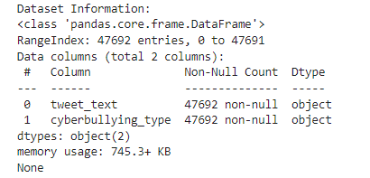
Dataset
Cyberbullying Detection Dataset: A curated dataset of labeled text samples extracted from social media and online forums that exhibit both bullying and non-bullying interactions (Cyberbullying Detection).

Slide 4
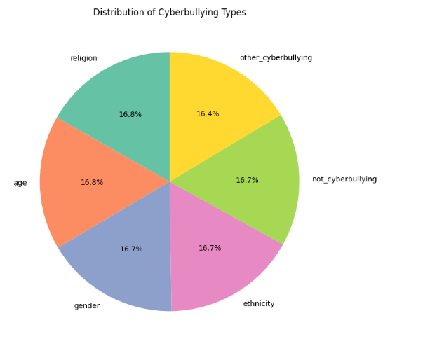
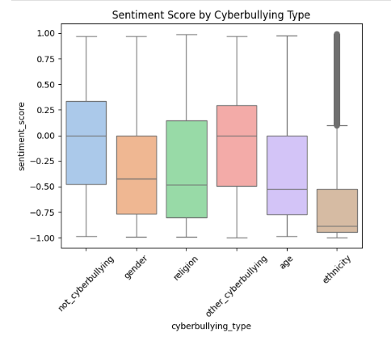
Cyberbullying Types

Slide 5
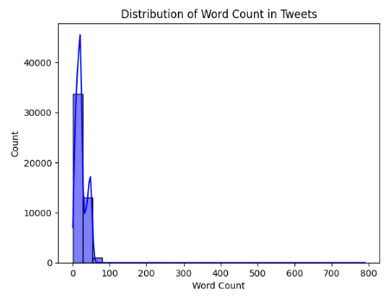
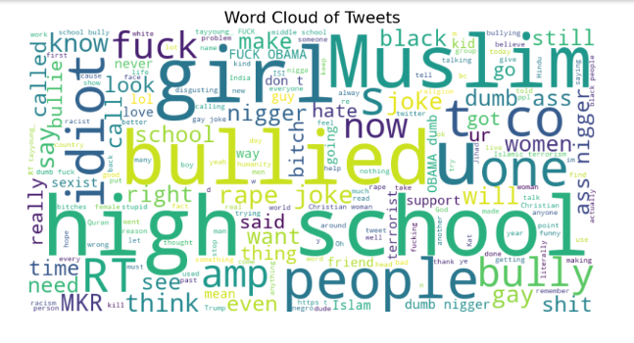
Tweets Distribution

Slide 6
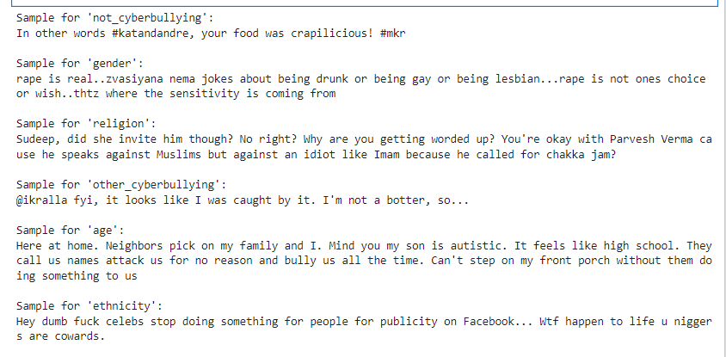
Overview of tweets classes

Slide 7
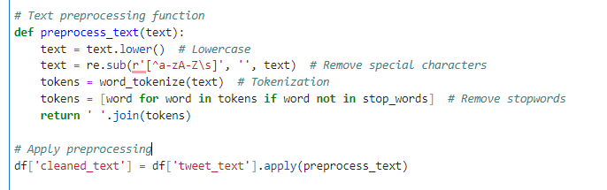
Preprocessing
Tokenization, Normalization, and StopwordRemoval
The code performs text preprocessing by converting the text to lowercase, removing special characters, and tokenizing it.
It then filters out stopwords using NLTK's stopword list, ensuring that only meaningful words are retained.
The cleaned text is stored in a new column, 'cleaned_text', in the dataframe for further analysis or modeling.

Slide 8
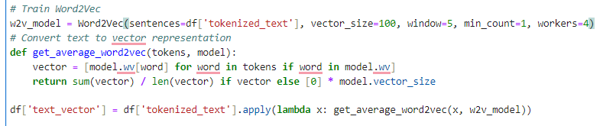
Preprocessing
Feature Extraction with Word Embeddings
The code trains a Word2Vec model on the tokenized text, then converts each text into a vector by averaging the word embeddings of its tokens, storing the result in a new column, 'text_vector'.

Slide 9
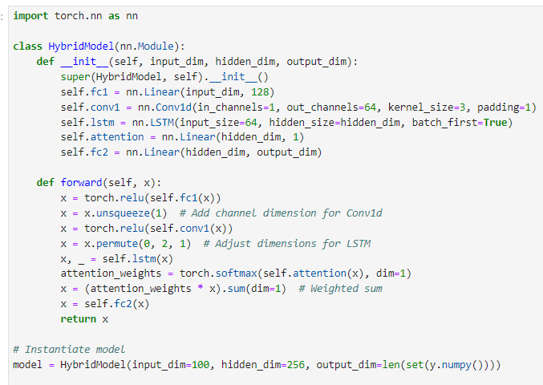
Model: Hybrid Model (CNN + RNN + Attention)
The HybridModel combines fully connected layers, convolution, LSTM, and attention for feature extraction and classification tasks

Slide 10
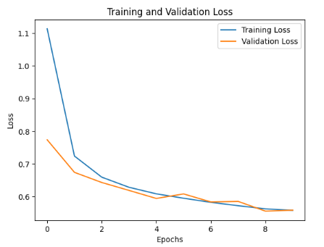
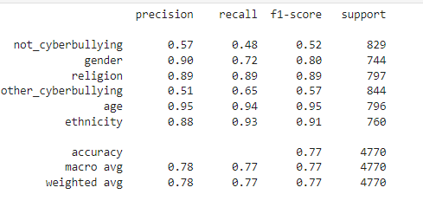
Hybrid Model Performance
The graph shows a steady decrease in both training and validation loss, with validation loss slightly stabilizing after a few epochs.
The Hybrid Model achieved an overall accuracy of 77%, with notable performance in age classification (accuracy 95%) and religion (accuracy 89%).

Slide 11
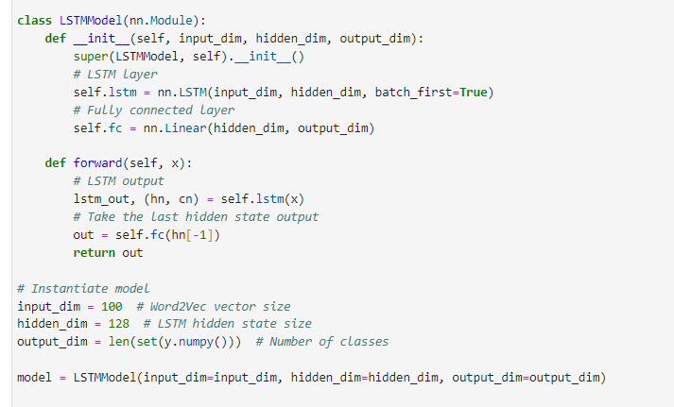
LTSM MODEL
The LSTMModel processes input through an LSTM layer followed by a fully connected layer for binary classification, detecting whether the text contains cyberbullying

Slide 12
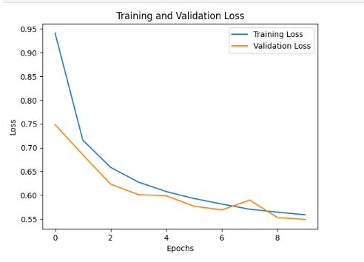
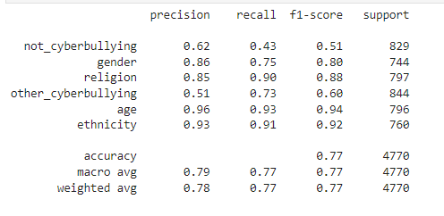
LTSM MODEL Performance
The LSTM model achieved an overall accuracy of 77%, with strong performance in age (accuracy 96%) and ethnicity (accuracy 93%).

Slide 13
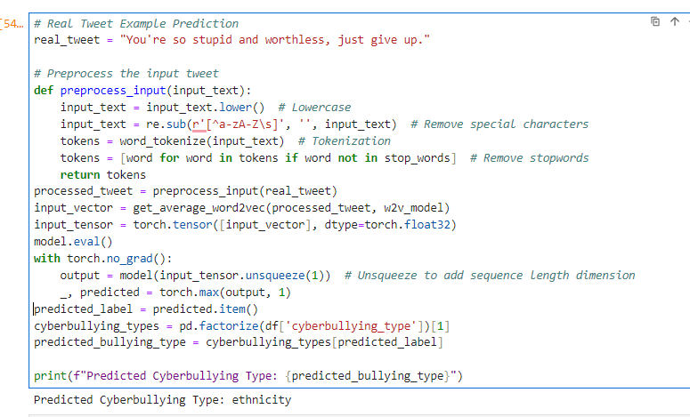
Deployment

Slide 14
Cited Work
Jadhav Patil, A., Nakhate, M., Bulani, R., Verma, R., & Jain, A. (2021). Real-time Cyberbullying Detection Using ML and NLP. D. Y. Patil College of Engineering, Pune, Maharashtra, India.
Bhatia, B., Verma, A., Anjum, & Katarya, R. (2020). Analysing Cyberbullying using Natural Language Processing by Understanding Jargon in Social Media. Delhi Technological University, New Delhi, India.
Wan Ali, W. N. H., Mohd, M., & Fauzi, F. (2018). Cyberbullying Detection: An Overview. Centre for Cyber Security, Faculty of Information Science & Technology, Universiti Kebangsaan Malaysia, Bangi, Selangor.

Slide 15

"Thank you for taking the time to listen to our presentation. We appreciate your support and interest in our project. Your encouragement means a lot to us!"

